Slide 1


How to create Cloud native Java Microservices with MicroProfile, Watson, Open Liberty and Cloudant
Jamie Coleman, Developer Advocate: MicroProfile, Open Liberty and WebSphere
Helena Smith, WebSphere Application Server Liberty Development Manager
Scott Curtis, Software Engineering Intern
@Jamie_Lee_C
@helenasmith_ibm
https://www.linkedin.com/in/scott-c-curtis/

Slide 2
Ready to get your hands dirty?
This Workshop is Open Sourced at: https://github.com/jamiecoleman92/Liberty-Watson-Cloud-Workshop
Follow the instructions in the “Before you begin” section of the README.md to:
Install Pre-requisites
Prime Maven and Docker Caches

Slide 3
Workshop hands-on content
Cloud-native Java Workshop
Workshop Preparation
Pre-requisites
Downloads
Introduction
Module 1: REST Foundation with Watson and Cloudant
Creating a RESTful web service
Injecting dependencies into microservices
Consuming RESTful services with template interfaces
Utilizing a Watson service on the IBM Cloud
Storing data on the cloud with Cloudant
Module 2: Scalable Microservice Development
Configuring Microservices
Building fault-tolerant microservices
Securing microservices
Documenting RESTful APIs
Module 3: Microservice Observability
Providing metrics from a microservice
Adding health reports to microservices
Enabling distributed tracing in microservices
Module 4: Microservice Deployment and Update
Deploying microservices to Kubernetes
Configuring microservices running in Kubernetes
Checking the health of microservices on Kubernetes
Deploying microservices to IBM Cloud

Slide 4
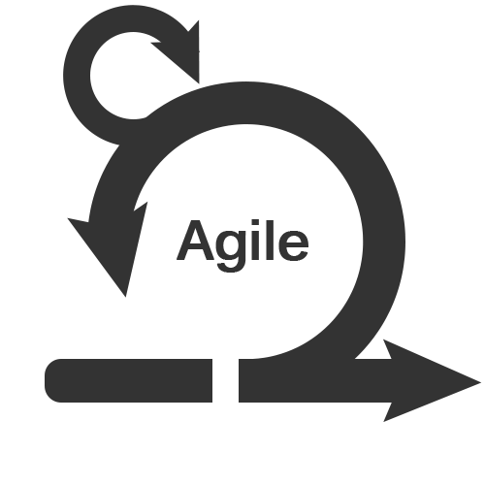
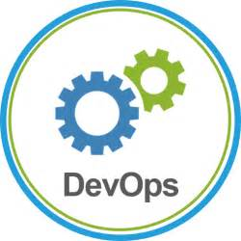
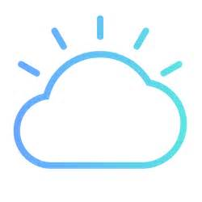
Agile & DevOps & Cloud & Microservices
+
+
+
service A
service C
service B
Notes:
The ability to put something into production every couple of week or even every commit led to infrastructure pressure. An application deployment isn’t possible without infrastructure, and cloud was here to help. The availability of hardware or platforms on tap through cloud mean buy cycles of months were no longer necessary.

Slide 5
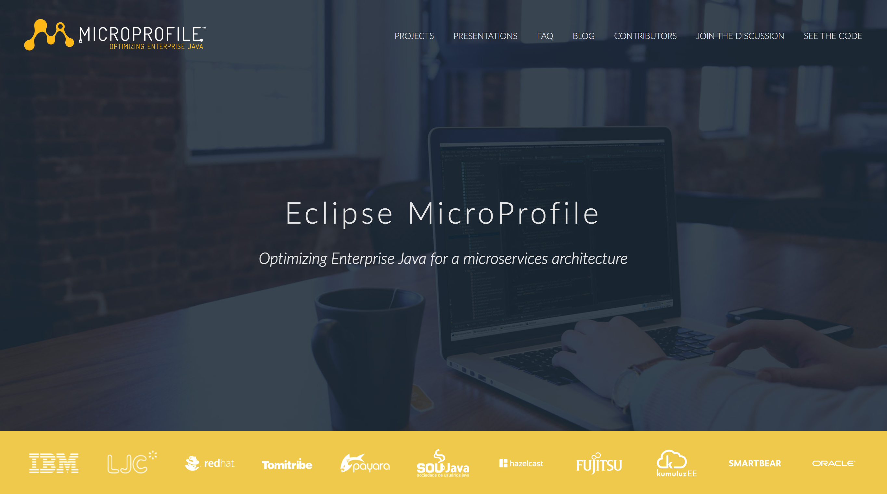
Notes:
Java EE 8 progress was very slow.
Cloud-native requirements not being addressed quickly enough
MicroProfile set up in Mid 2016 as an industry collaboration.

Slide 6
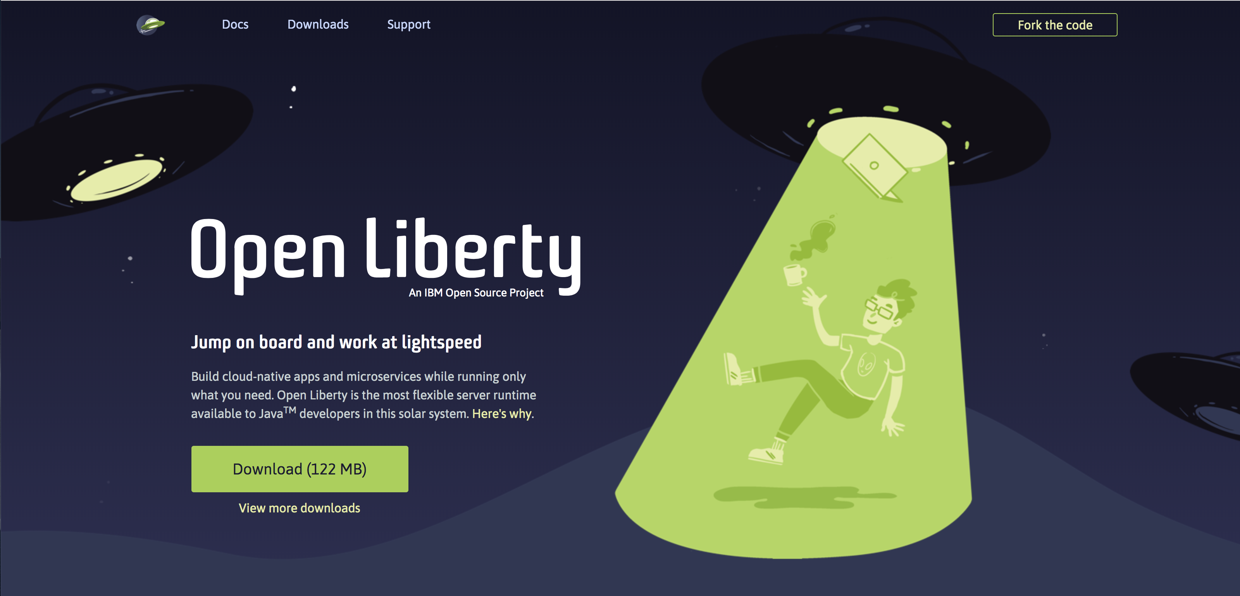
openliberty.io

Slide 7
Module 1
REST Foundation with Watson and Cloudant

Slide 8
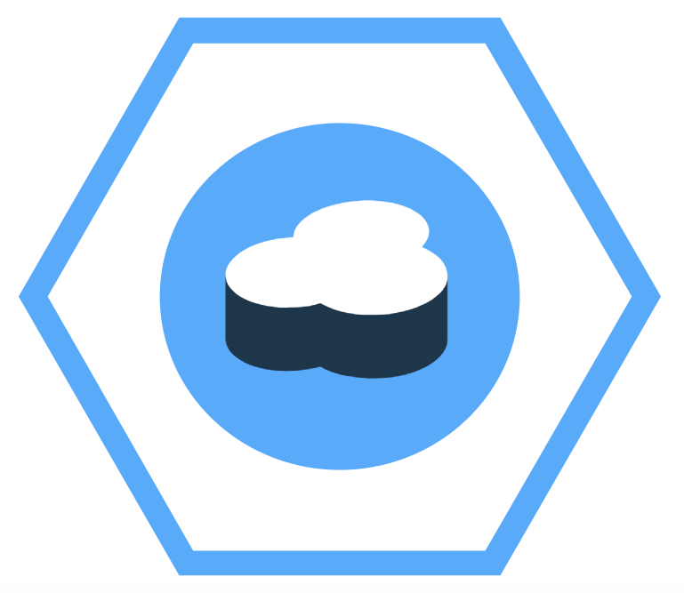
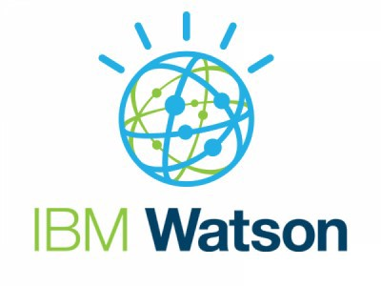



Eclipse MicroProfile
With Watson and Cloudant
JAX-RS
Rest Client
CDI
JSON-P
JSON-B
microprofile.io

Slide 9
JAX-RS
B
@Path("properties")
public class PropertiesResource {
@GET
@Produces(MediaType.APPLICATION_JSON)
public JsonObject getProperties() {…}
}
@ApplicationPath("System")
public class SystemApplication extends Application {}

Slide 10
MicroProfile REST Client
A
B
@Dependent
@RegisterRestClient
@RegisterProvider(UnknownUrlExceptionMapper.class)
@Path("/properties")
public interface SystemClient {
@GET
@Produces(MediaType.APPLICATION_JSON)
public Properties getProperties() throws UnknownUrlException, ProcessingException;
}
@Inject
@RestClient
private SystemClient defaultRestClient;
io.openliberty.guides.inventory.client.SystemClient/mp-rest/url=http://localhost:9080/system

Slide 11
CDI
A
B
public class InventoryManager {
@Inject
private SystemClient systemClient;
…
}

Slide 12
JSON-B & JSON-P
A
B
public class InventoryList {
private List<SystemData> systems;
public InventoryList(List<SystemData> systems) {
this.systems = systems;
}
public List<SystemData> getSystems() {
return systems;
}
public int getTotal() {
return systems.size();
}
}
...
@GET
@Produces(MediaType.APPLICATION_JSON)
public InventoryList listContents() {
return manager.list();
}

Slide 13
Watson Tone Analyzer

Slide 14
Cloudant No-Sql Database

Slide 15
Module 2
Scalable Microservice Development

Slide 16
Eclipse MicroProfile
With Watson and Cloudant
Open API
JWT Propagation
Fault Tolerance
Config
JAX-RS
Rest Client
CDI
JSON-P
JSON-B
microprofile.io

Slide 17
MicroProfile OpenAPI
openapi: 3.0.0
info:
title: Inventory App
description: App for storing JVM system properties of various hosts.
license:
name: Eclipse Public License - v 1.0
url: https://www.eclipse.org/legal/epl-v10.html
version: "1.0"
servers: - url: http://localhost:{port} description: Simple Open Liberty.
variables:
port:
description: Server HTTP port.
default: "9080"
paths:
/inventory/systems:
get:
summary: List inventory contents.
description: Returns the currently stored host:properties pairs in the inventory.
operationId: listContents
responses:
200:
description: host:properties pairs stored in the inventory.
content:
application/json:
schema:
$ref: '#/components/schemas/InventoryList’
….
http://localhost:9080/openapi/ui
A
B
Notes:
@GET
@Produces(MediaType.APPLICATION_JSON)
@APIResponse(
responseCode = "200",
description = "host:properties pairs stored in the inventory.",
content = @Content( mediaType = "application/json",
schema = @Schema( type = SchemaType.OBJECT,
implementation = InventoryList.class)))
@Operation( summary = "List inventory contents.",
description = "Returns the stored host:properties pairs.")
public InventoryList listContents() { return manager.list(); }

Slide 18
MicroProfile JWT
A
B
@GET
@RolesAllowed({ "admin", "user" })
@Path("{hostname}")
@Produces(MediaType.APPLICATION_JSON)
public Response getPropertiesForHost(@PathParam("hostname") String hostname,
@Context HttpHeaders httpHeaders) {…}

Slide 19
MicroProfile Fault Tolerance
A
B
@Fallback(fallbackMethod = "fallbackForGet")
public Properties get(String hostname) throws IOException {
return invUtils.getProperties(hostname);
}

Slide 20
MicroProfile Config
A
B
{
"config_ordinal":150,
"io_openliberty_guides_inventory_inMaintenance":true
}
@Inject
@ConfigProperty(name = "io_openliberty_guides_inventory_inMaintenance")
private Provider<Boolean> inMaintenance;
config_ordinal=100
io_openliberty_guides_inventory_inMaintenance=false

Slide 21
Module 3
Microservice Observability

Slide 22
Eclipse MicroProfile
With Watson and Cloudant
Metrics
Health Check
Open Tracing
Open API
JWT Propagation
Fault Tolerance
Config
JAX-RS
Rest Client
CDI
JSON-P
JSON-B
microprofile.io

Slide 23
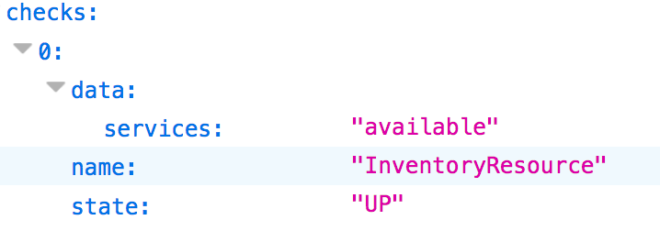
MicroProfile Health
A
B
@Health
@ApplicationScoped
public class InventoryResource implements HealthCheck {
... public boolean isHealthy() {...}
@Override
public HealthCheckResponse call() {
if (!isHealthy()) {
return HealthCheckResponse.named(“InventoryResource”).withData(…).down().build();
}
return HealthCheckResponse.named(“InventoryResource”).withData(…).up().build();
} }

Slide 24
MicroProfile Metrics
A
B
@Timed(name = "inventoryPropertiesRequestTime",
absolute = true,
description = "Time needed to get the properties of" +
"a system from the given hostname")
public Properties get(String hostname) {
return invUtils.getProperties(hostname);
}

Slide 25
MicroProfile OpenTracing
JAX-RS methods are automatically traced by default
A
B
@Traced(value = true, operationName = "InventoryManager.list")
public InventoryList list() {
return new InventoryList(systems);
}
Notes:
@Traced(value = true, operationName = "InventoryManager.list") public InventoryList list() { return ... }

Slide 26
Module 4
Microservice Deployment and Update

Slide 27
Microservice Deployment
Docker
Kubernetes
Istio
Metrics
Health Check
Open Tracing
Open API
JWT Propagation
Fault Tolerance
Config
JAX-RS
Rest Client
CDI
JSON-P
JSON-B
microprofile.io

Slide 28
Docker
docker build -t ol-runtime --no-cache=true .
docker run -d --name rest-app -p 9080:9080 -p 9443:9443 -v <absolute path to guide>/start/target/liberty/wlp/usr/servers:/servers ol-runtime
build, ship and run any app, anywhere
Notes:
Docker is an open platform for developing, shipping, and running applications. Docker enables you to separate your applications from your infrastructure so you can deliver software quickly. With Docker, you can manage your infrastructure in the same ways you manage your applications. By taking advantage of Docker’s methodologies for shipping, testing, and deploying code quickly, you can significantly reduce the delay between writing code and running it in production.
Docker uses a client-server architecture. The Docker client talks to the Docker daemon, which does the heavy lifting of building, running, and distributing your Docker containers. The Docker client and daemon can run on the same system, or you can connect a Docker client to a remote Docker daemon. The Docker client and daemon communicate using a REST API, over UNIX sockets or a network interface.
The Docker daemon
The Docker daemon (dockerd) listens for Docker API requests and manages Docker objects such as images, containers, networks, and volumes. A daemon can also communicate with other daemons to manage Docker services.
The Docker client
The Docker client (docker) is the primary way that many Docker users interact with Docker. When you use commands such as docker run, the client sends these commands to dockerd, which carries them out. The docker command uses the Docker API. The Docker client can communicate with more than one daemon.
Docker registries
A Docker registry stores Docker images. Docker Hub is a public registry that anyone can use, and Docker is configured to look for images on Docker Hub by default. You can even run your own private registry. If you use Docker Datacenter (DDC), it includes Docker Trusted Registry (DTR).
When you use the docker pull or docker run commands, the required images are pulled from your configured registry. When you use the docker push command, your image is pushed to your configured registry.
Docker objects
When you use Docker, you are creating and using images, containers, networks, volumes, plugins, and other objects. This section is a brief overview of some of those objects.
Images
An image is a read-only template with instructions for creating a Docker container. Often, an image is based on another image, with some additional customization. For example, you may build an image which is based on the ubuntu image, but installs the Apache web server and your application, as well as the configuration details needed to make your application run.
You might create your own images or you might only use those created by others and published in a registry. To build your own image, you create a Dockerfile with a simple syntax for defining the steps needed to create the image and run it. Each instruction in a Dockerfile creates a layer in the image. When you change the Dockerfile and rebuild the image, only those layers which have changed are rebuilt. This is part of what makes images so lightweight, small, and fast, when compared to other virtualization technologies.
Containers
A container is a runnable instance of an image. You can create, start, stop, move, or delete a container using the Docker API or CLI. You can connect a container to one or more networks, attach storage to it, or even create a new image based on its current state.
By default, a container is relatively well isolated from other containers and its host machine. You can control how isolated a container’s network, storage, or other underlying subsystems are from other containers or from the host machine.
A container is defined by its image as well as any configuration options you provide to it when you create or start it. When a container is removed, any changes to its state that are not stored in persistent storage disappear.

Slide 29
Container Orchestration - Kubernetes
Running containers across many different machines
Scaling
Keeping storage consistent with multiple instances of an application
Load balancing
Manage containers automatically

Slide 30
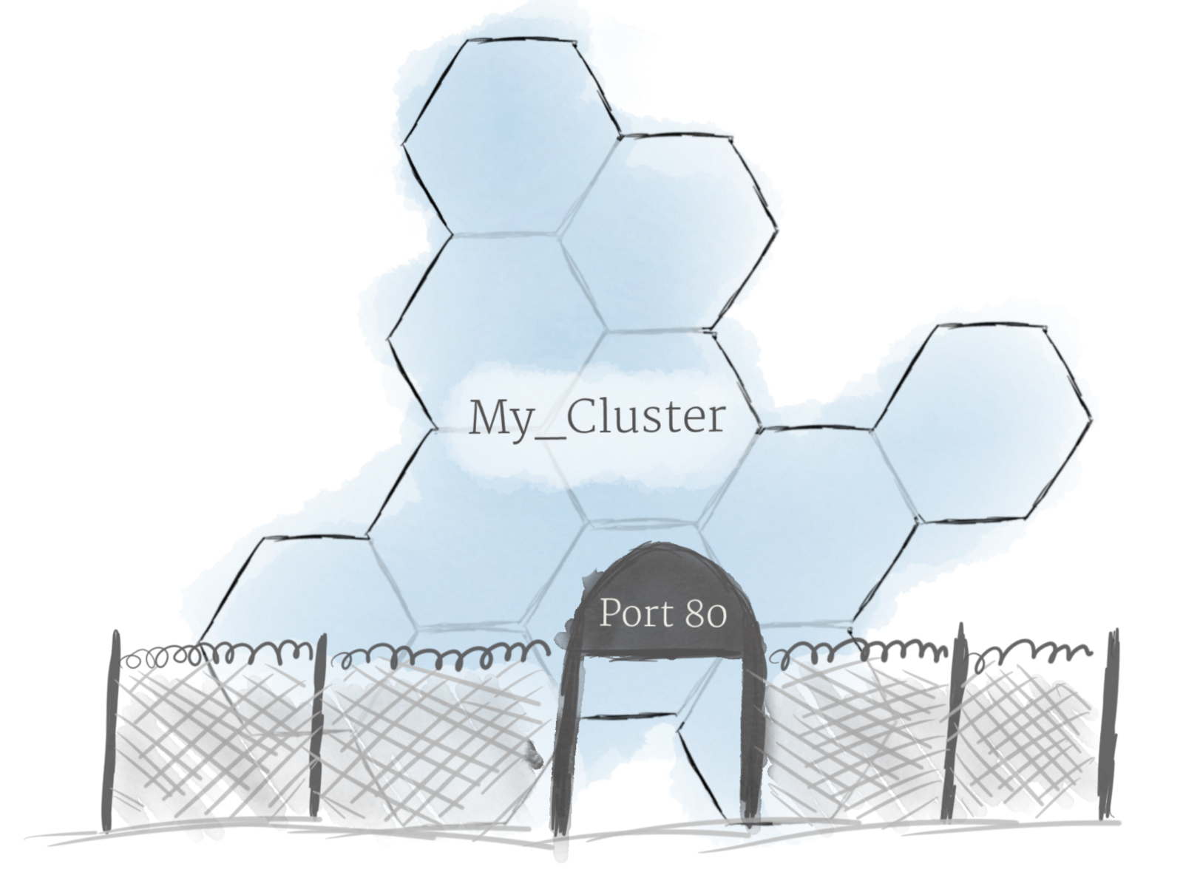
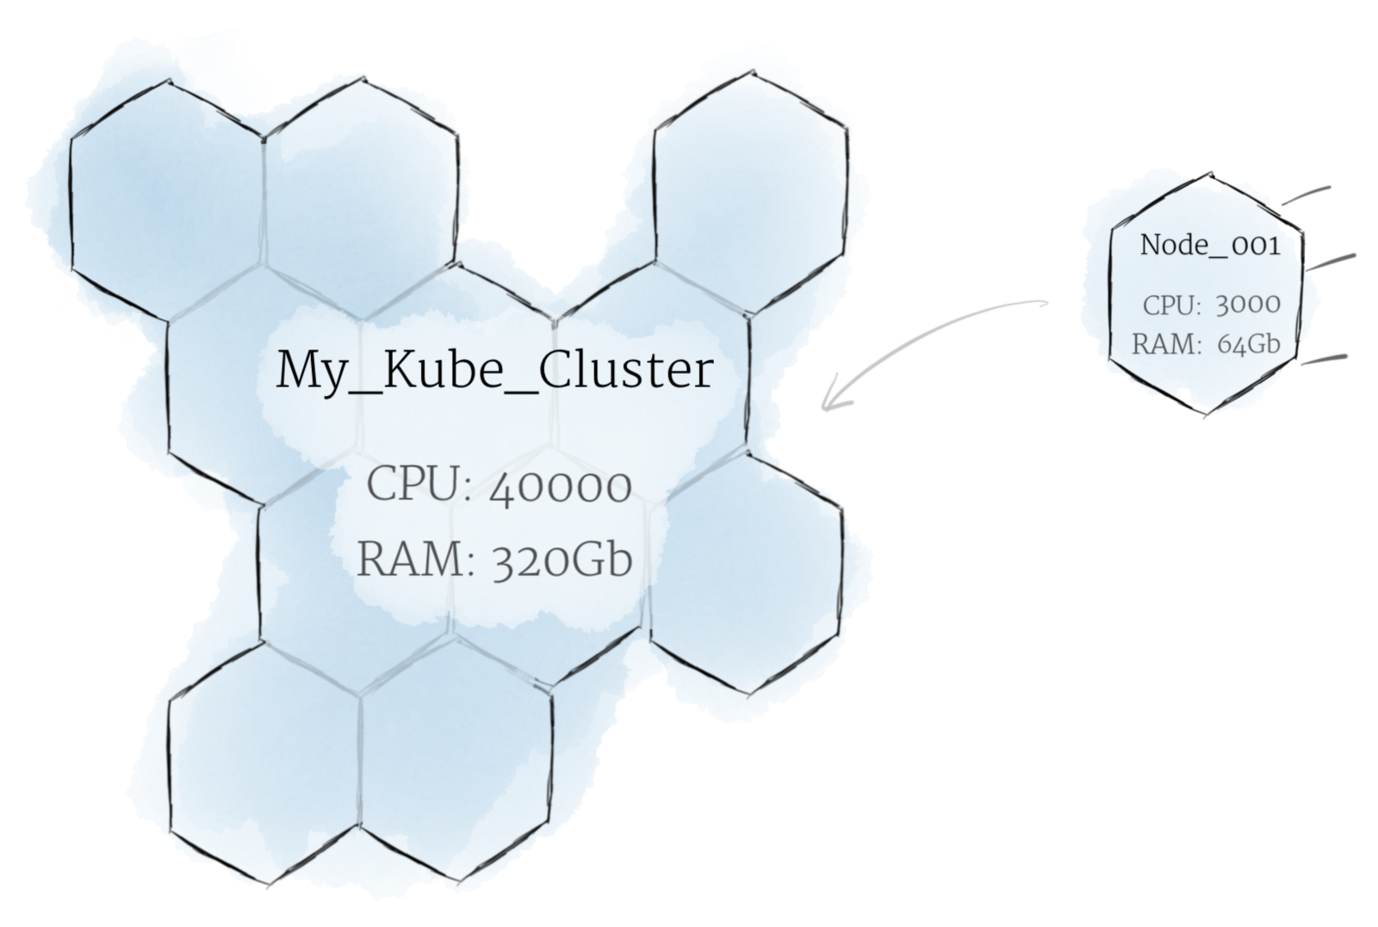
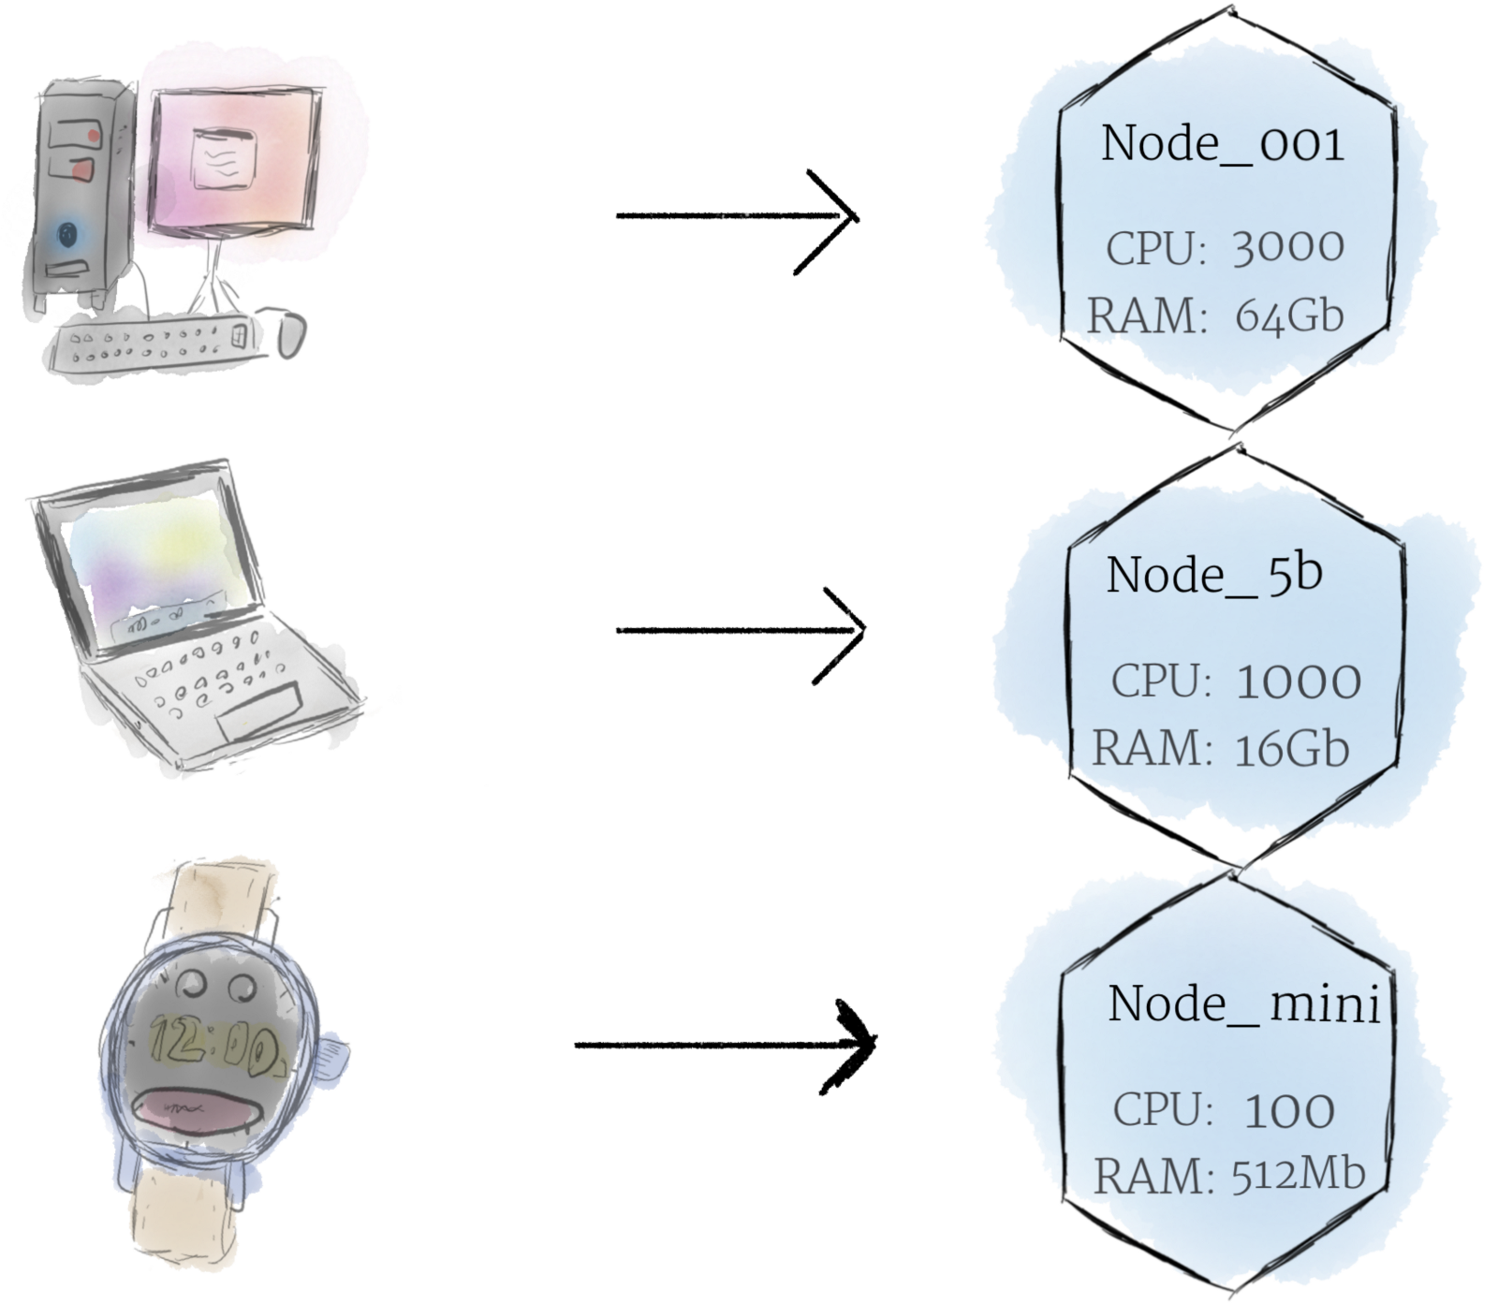
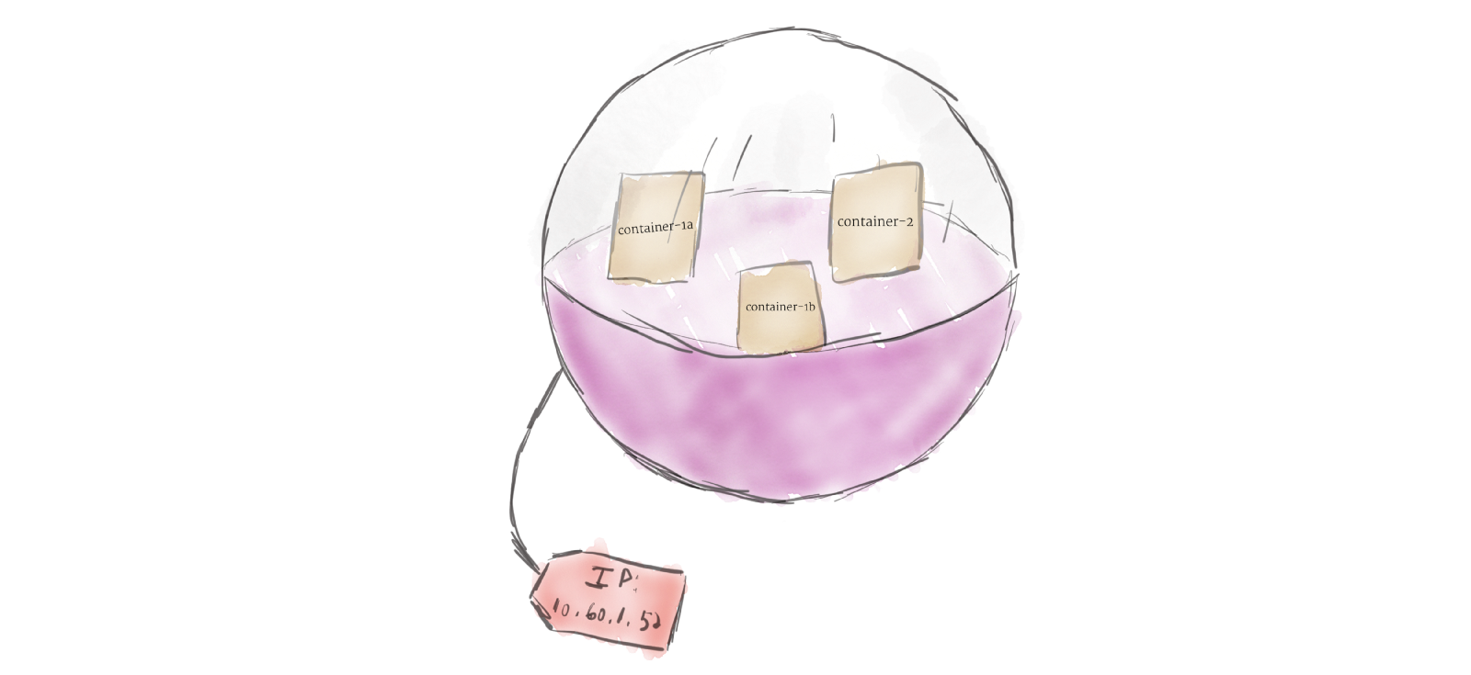
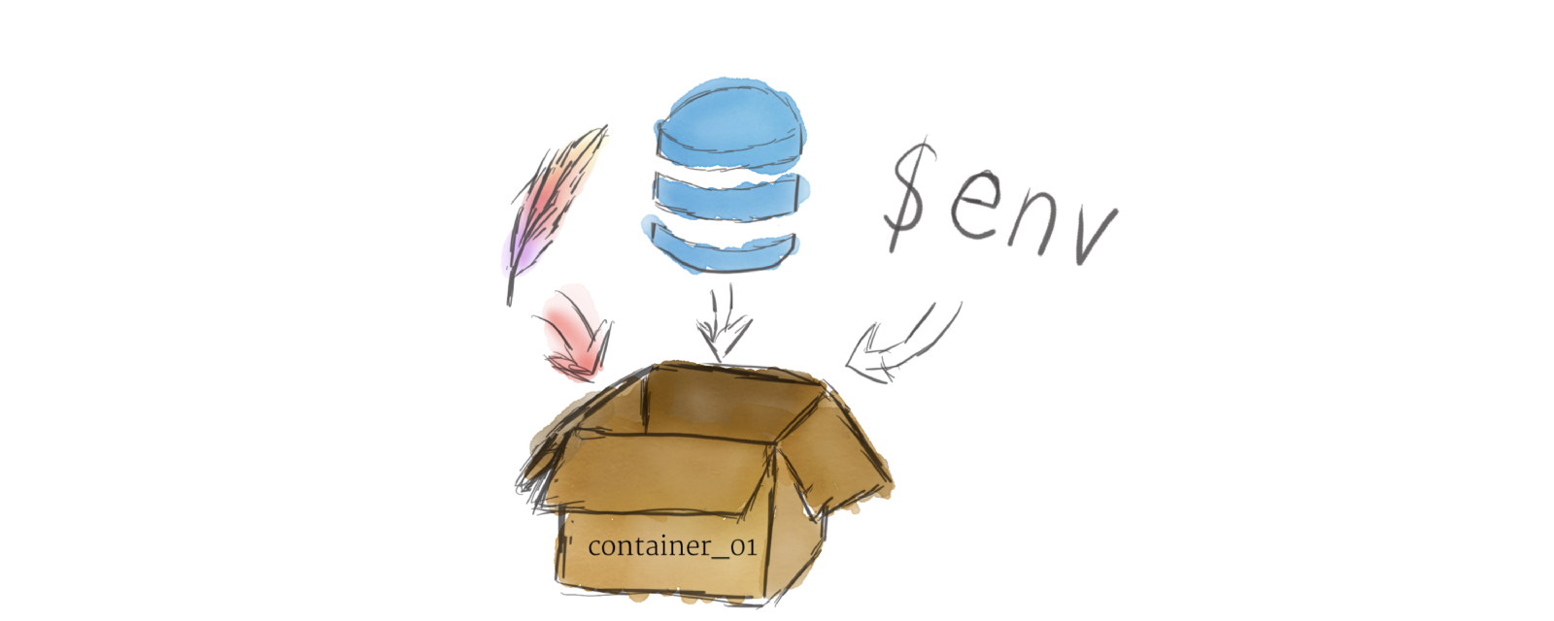
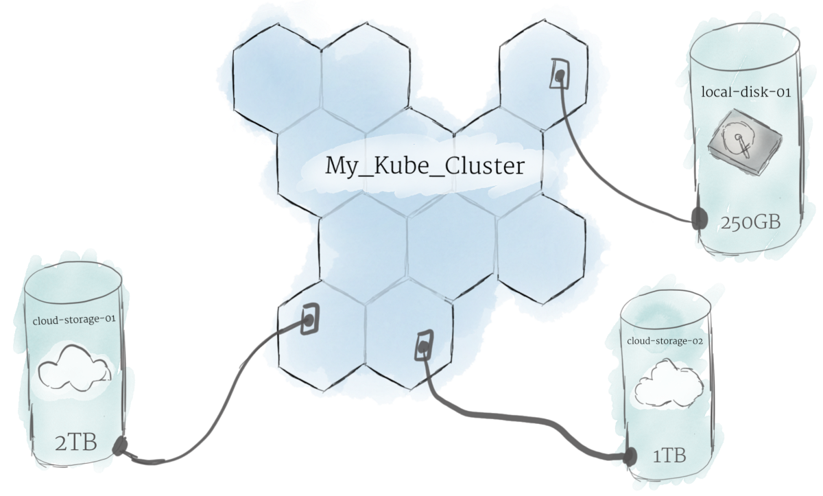
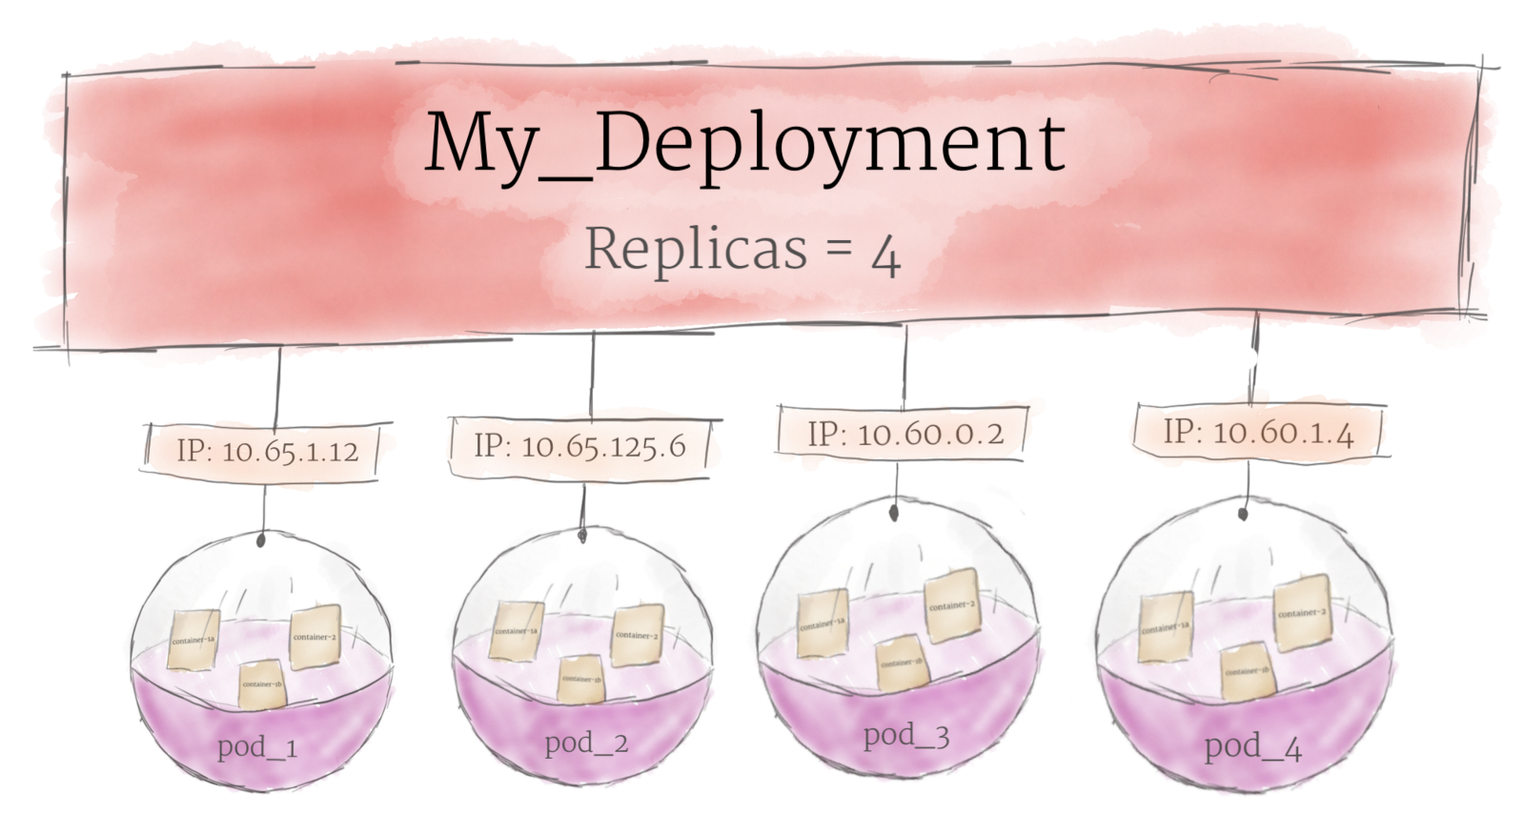
Kubernetes Terms
Cluster
Ingress
Nodes
Pods
Containers
Persistence volumes
Deployments
Images from https://medium.com/google-cloud/kubernetes-101-pods-nodes-containers-and-clusters-c1509e409e16

Slide 31
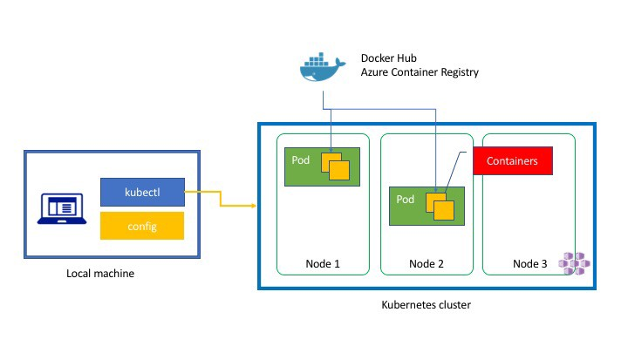
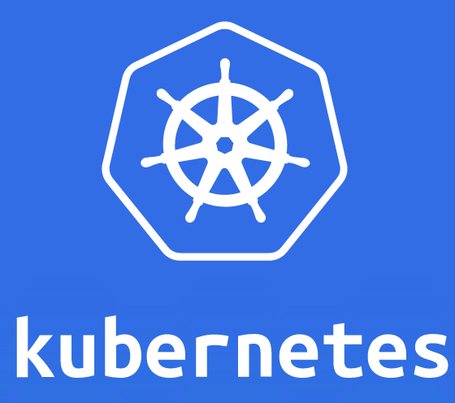
Kubernetes – k8s
Notes:
Kubernetes is an open source container orchestration platform, allowing large numbers of containers to work together in harmony, reducing operational burden. It helps with things like:
Running containers across many different machines
Scaling up or down by adding or removing containers when demand changes
Keeping storage consistent with multiple instances of an application
Distributing load between the containers
Launching new containers on different machines if something fails
Node:
The Node is nothing but a fancy term for a computer, it could be a physical computer or could be a computing instance like AWS EC2 instances.
Cluster:
The cluster is a collection of Nodes (computers) related to each other and work together.
Each cluster contains Kubernetes nodes. Nodes might be physical machines or VMs.
Nodes run pods, the most basic Kubernetes objects that can be created or managed. Each pod represents a single instance of an application or running process in Kubernetes, and consists of one or more containers. Kubernetes starts, stops, and replicates all containers in a pod as a group. Pods keep the user’s attention on the application, rather than on the containers themselves.
Pod:
The Pod is nothing but one or more docker containers, sharing the same network card (having the same localhost).
pods are the basic unit of deployment in Kubernetes, they get deployed to the nodes of the cluster, and these nodes can have one or more pods on them, it’s up to Kubernetes to arrange the pods between the nodes. Each pod is allocated its own IP address. Containers within a pod share this IP address, port space and can find each other via localhost.
Replica:
The replica is a clone of a pod, replicas are needed to distribute the load.
Service:
A service is a group of pods that running somewhere in the cluster and they provide the same functionality. A service describes how a given group of pods (or other Kubernetes objects) can be accessed via the network. As the Kubernetes documentation puts it, the pods that constitute the back end of an application might change, but the front end shouldn’t have to know about that or track it. Services make this possible. Services fix this problem by providing an abstraction over Pods and provide an addressable method of communicating with pods.
Deployment:
The deployment is what you use to describes your desired state to Kubernetes.

Slide 32
MicroProfile Config with Kubernetes
A
B
env:
- name: GREETING
valueFrom:
configMapKeyRef:
name: greeting-config
key: message
kubectl create configmap greeting-config --from-literal message=Greetings...
@Inject
@ConfigProperty(name = "GREETING")
private String greeting;

Slide 33
MicroProfile Health with Kubernetes
A
B
readinessProbe:
httpGet:
path: /health
port: 9080
initialDelaySeconds: 15
periodSeconds: 5
failureThreshold: 1

Slide 34
Challenges with Kubernetes
The network among microservices is not reliable.
How can my service handle unpredictable failures and retry?
How can I monitor and trace my microservices?
As I develop multiple versions of my microservices, how can I easily dark launch and shift traffic?
How can I ensure the communication among microservices is secure?
How can I add enforce policies on my microservices?
Notes:
Kubernetes is a deployment platform but….

Slide 35
Wrap-up
Thank you

Slide 36
Useful Links
https://github.com/jamiecoleman92/Liberty-Watson-Cloud-Workshop
https://microprofile.io
https://openliberty.io/guides
https://docs.docker.com/get-started/
https://kubernetes.io/docs/tutorials/kubernetes-basics/
https://istio.io/docs/setup/kubernetes/quick-start/

Slide 37
Thank you!

